Slide 1
Altisource Asset Management Corporation
(“AAMC”)
AUGUST 14, 2023
3

Slide 2
Forward-looking Statement
Certain comments made in this presentation may contain forward-looking statements in relation to operations, financial condition and financial results of Altisource Asset Management Corporation (“AAMC”) and such statements involve a number of risks and uncertainties. Forward looking statements are usually identified by or are associated with such words as “intend,” “plan,” “believe,” “estimate,” “expect,” “anticipate,” “hopeful,” “should,” “may,” “will,” “could,” “encouraged,” “opportunities,” “potential,” and/or the negatives or variations of these terms or similar terminology. In particular, forward looking statements include, but are not limited to, statements as to our ability to develop and implement our new alternative lending business, including the ability to obtain leverage and potential return on equity, the impact of current inflationary economic and market conditions, including the current rising interest rate environment and development in the credit market, and our ability to develop, improve and optimize our information technology to support our business plans. These statements reflect management’s current beliefs and estimates of future economic circumstances, industry conditions, Company performance, and Company financial results and are not guarantees of future performance. All such forward-looking statements are based on current expectations and assumptions that are subject to certain risks and uncertainties that could cause actual results to differ materially from those expressed or implied in the relevant forward-looking statement. With respect to the growth and returns from our alternative lending business, our expectations depend on the ability to acquire and originate loans at attractive pricing, to obtain leverage, to successfully manage our loan portfolio and successfully dispose of loans at attractive levels. These risks and other risks are described in the Company’s filings with the Securities and Exchange Commission. Any forward-looking statements made in this presentation speak only as of the date of this presentation. Except as required by law, AAMC does not intend to update these forward-looking statements and undertakes no duty to any person to provide any such update under any circumstances.
AAMC
2

Slide 3
Challenge Range and heat generation over an EV’s drive cycle, i.e. Efficiency.
Solution Select and utilize multiple motors optimized for vehicle operations (patents awarded).
Outcome 50% reduction in energy loss and heat generation resulting in an 8% increase ¹ in range.
Market Size EVs represent a +$299 billion annual market by 2030².
Roadmap Next steps: prototype development & technology demonstrator (12 to 18 months - $4 to 7 million), followed immediately by commercialization.
Team World class engineering team with exceptional networks across multiple industries and aligned incentives.
.
Alpha Control
Purple Sector
IEA Forecast, global EV sales https://www.iea.org/reports/global-ev-outlook-2022
4

Slide 4
Challenge
“…for an electric motor, it’s easy to get peak power for a short period of time – it’s hard to have sustained peak power, because you overheat, and it’s hard to get high efficiency over a complicated drive cycle. Those tend to be the problems we wrestle with.” Elon Musk, CEO, Tesla
Two of the greatest challenges in electric vehicles are range and heat dissipation.
Corroborated by both Elon Musk and Peter Rawlinson.
“… less waste heat to dispel means you can have smaller radiators; smaller radiators lets you mold the car more aerodynamically, reducing losses to wind resistance. It all adds up.”
Peter Rawlinson, CEO, Lucid Motor

Slide 5
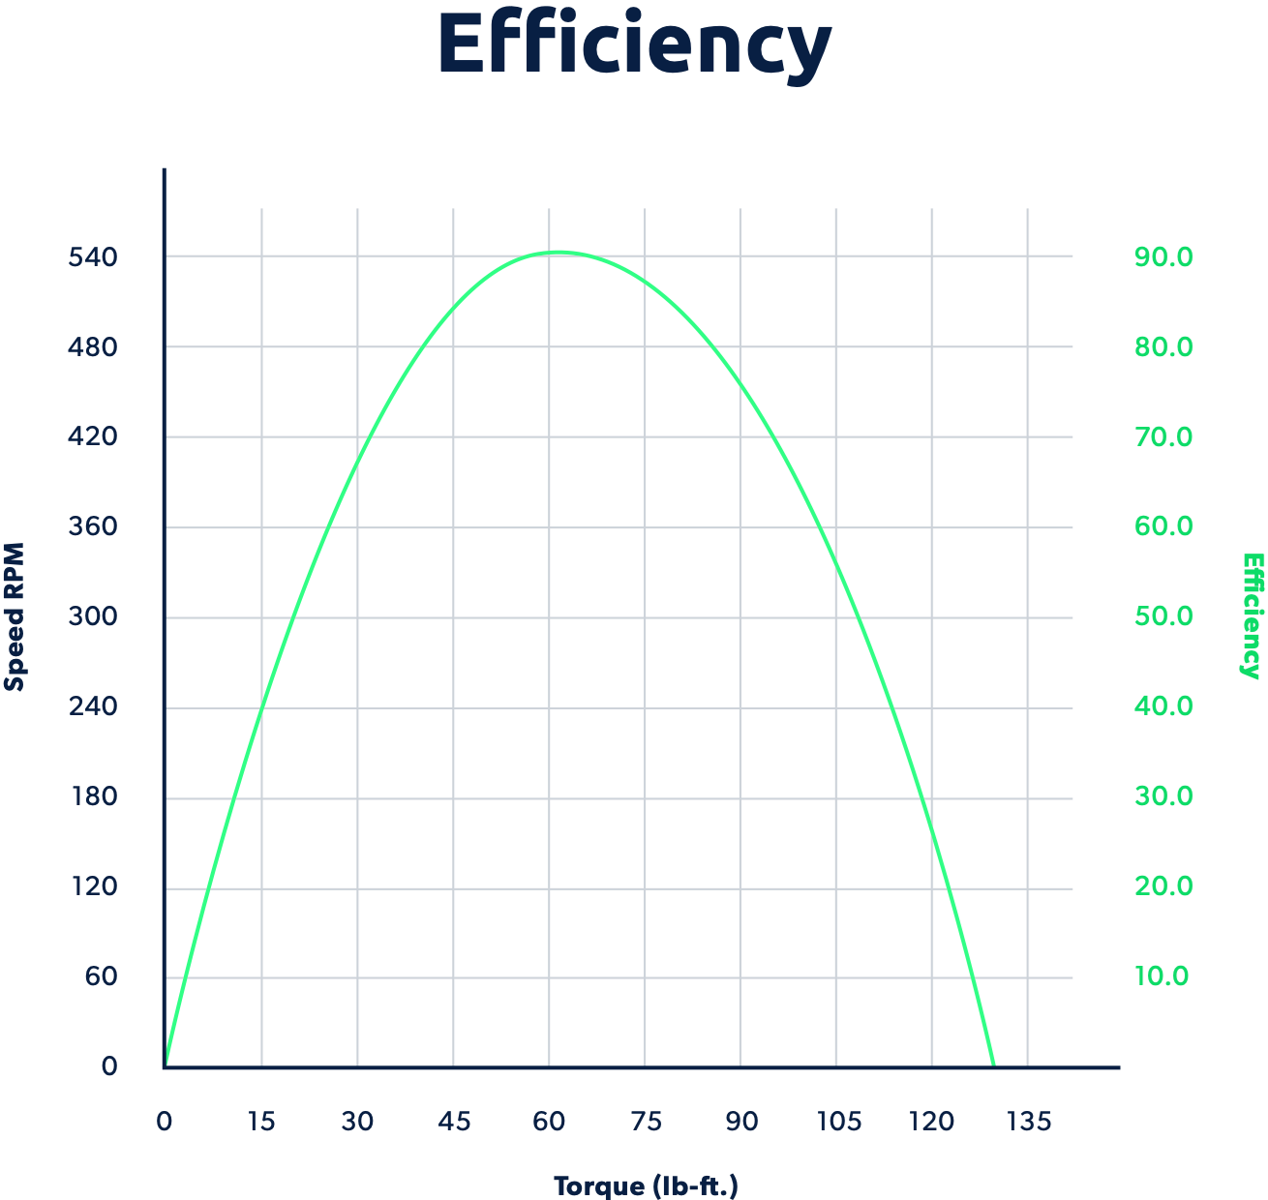
Solution
Alpha Control. solves the two primary problems of electric vehicles (automobiles, trucks, construction/mining equipment, aircraft):
Heat generation and
Range which are a function of Efficiency.
Heretofore, peak efficiency was achieved over a
very narrow range of torque and RPM.
Outside of this range, efficiency decreases, and heat generation rapidly increases.

Slide 6
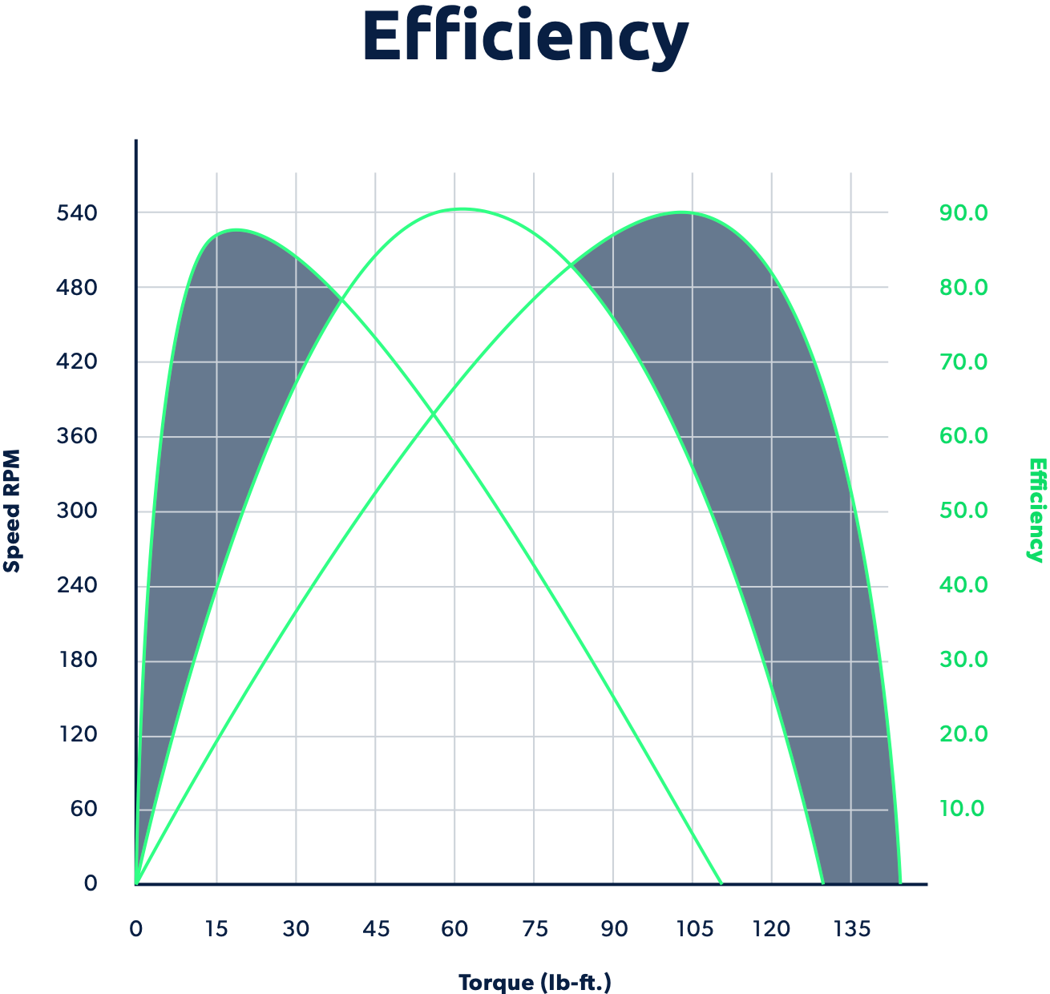
Solution
Patented solution reduces energy loss and heat generation by utilizing multiple small motors instead of one large motor with each motor efficient at a different combination of torque and RPM.
Utilize multi-variate optimization to determine
motor selection (including braking) to globally
optimize over the entire trip.
Areas in blue represent enhanced efficiency and decreased heat generation. The greater the variability in torque and RPM, the greater the savings.

Slide 7
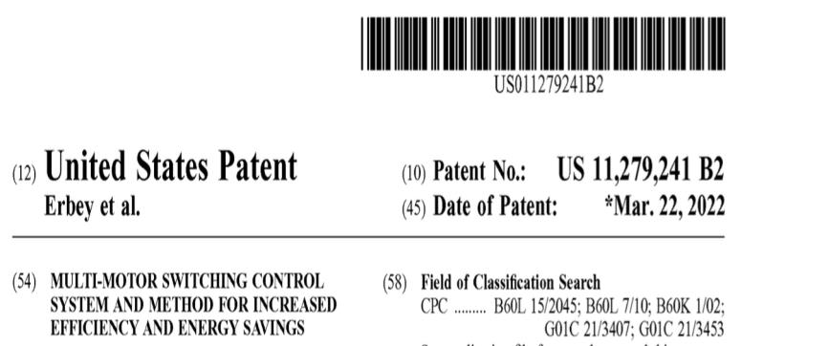
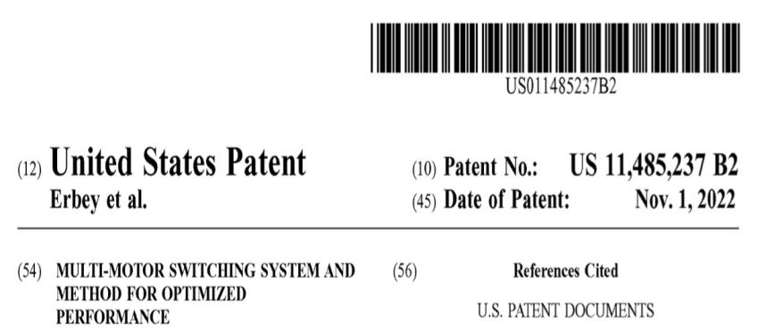
Patent Protection
Alpha Control owns two US patents and one UK patent with additional patents pending.
Highly rated patent counsel Mayer Brown

Slide 8
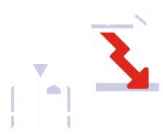
Outcome
50% reduction in energy loss and heat generation.
Enables bespoke motor configurations for materially enhanced performance and/or range.

Slide 9
Technical and commercial assessment¹
Patent approach evaluated
Patent mathematics has been reviewed and evaluated by world class automotive and motorsport engineering team.
Simulation, modelling & testing
Simulation models developed and correlation testing completed at award winning IAAPS advanced propulsion center.
Commercial feasibility and value assessed
Commercial feasibility evaluated and value to OEM assessed.
1. Purple Sector

Slide 10
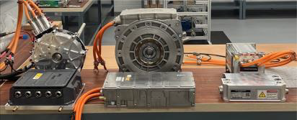
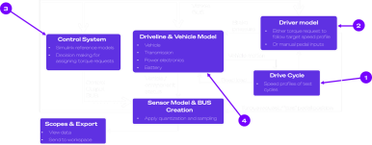
Technical development
Tesla model 3 standard range (single motor) used as the baseline vehicle
Patent evaluated
Simulation toolset developed & controller optimised
2 phases of physical testing on 3 different motors completed – simulations correlated in representative conditions
Low fidelity Model
High speed assessment
Matlab model – runs 3600x faster than real time
High fidelity model
Thorough evaluation
Simulink model – all parameters
These steps have generated the foundations for effective application of the patent and enabled commercial assessment

Slide 11
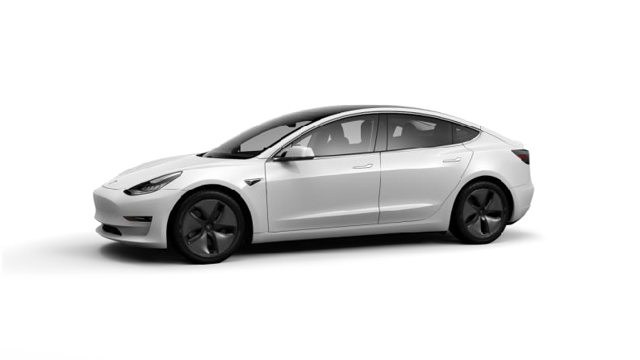
8.4%
Case study
1
Range increase
+31.4km additional range
Range was increased from 375.1km to 406.5km using the WLTP (Worldwide Harmonised Light Vehicle Test Procedure) combined cycle and a configuration with 2 motors and an optimized controller.
Patented Technology applied to a Tesla Model 3
1. Purple Sector

Slide 12
Commercial assessment
1
Using the technical toolset and findings, three business cases were assessed in application of the patented technology to the Tesla Model 3
Improve range & maximise retail price
Improve range and partially increase retail price
Maintain range and reduce battery size (reduce BOM cost)
$393m annually
$193m annually
$105m annually
Increase profit per vehicle of
$1.7k (increase retail price by 100% of perceived value of range extension)
Increase profit $850 per (increase retail price by 50% of perceived value of range extension)
Maintain retail price, implement lower specification battery for same range
Note – Market perceived value of range extension $54.25/km results in an increased list price of $1.7k per vehicle. All three cases assume patent technology only applied to 19% of Tesla vehicles
(% of Tesla’s sold as standard range variants in the USA). Cost of patent license + any non-recurring engineering costs to implement not considered.
1. Purple Sector
13

Slide 13
Development opportunities
Range benefits were limited by available motor technologies
Efficient motor design and selection of alternative existing motors that leverage patent technology for increased gains
Current motor design optimization in
automotive is focused on single motor use
Motors are capable of being 94% efficient but generally operate at a much lower level of efficiency
Potential efficiency gains are much higher than the 8.4% achieved with the Tesla Model 3 example
Further development to improve the business case and technology attractiveness for OEMs
1
2
3

Slide 14
Market potential
$996bn
1
Global light vehicle sales 2030, 97m units
30%
2
$299Bn
TGlobal EV sales 2030, 29.1m units
$9.27Bn
Serviceable
addressable market 2030
$49.5Bn
Total addressable market 2030
$1.7k profit per vehicle
19% utilisation
Note – 19% utilization will vary between manufacturers and sectors. $1.7k incremental profit margin will vary based on range improvement realized, BoM cost of vehicle and perceived customer value in different applications
SPG Global estimate https://www.spglobal.com/mobility/en/products/automotive-light-vehicle-sales-forecasts.html
IEA Forecast, global EV sales https://www.iea.org/reports/global-ev-outlook-2022

Slide 15
Seabird Technologies Ltd
Led by CEO Richard Draisey, ex-McLaren Racing Strategy & Finance Director Co-Founded by Alejandro Agag, Chairman of Formula E, Extreme E & E1
World class engineering team with vast experience spanning multiple industries
High performance automotive
Electric mobility
Formula One, Electric motorsport (Formula E, Extreme E, E1 Series)
Aerospace
Maritime
World Class Partner To Develop Prototype & Commercialize Product
Key Engineering team
Mark Mathieson, ex-Chief Engineer Powertrain Research at McLaren
Automotive
Nathan Baker, ex-VP Simulation Engineering, Arrival
Ciaran Branney, ex-Power Unit performance lead, Mercedes & McLaren Automotive

Slide 16
$7 to $8 million
1-3 | 4-6 |  |  | 7-9 |  |  | 10-12 |  | 13-15 | 16-18
Discovery
Concept Design
Detailed Design
Sourcing & Manufacturing
Assembly
Rig Testing
Vehicle Testing
Commercialisation
Prototype Development (Estimate)

Slide 17
Strong alignment of interest in our
development partners
Structure demonstrates conviction in technology and application by world class partner.
10% ownership in the Company when revenue attributable to
Partner’s efforts exceeds $500 million per annum.
Partner Development Contract
Exclusive worldwide distributor for two years:
10% of revenue from net sales directly attributable to
Partner’s efforts up to $250 million per annum.
20% of revenue from net sales directly attributable to
Partner’s efforts over $250 million per annum.
18

