Slide 1
Revolutionizing Electric Vehicle Efficiency with Intelligent Multi-Motor Technology

Slide 2
Information provided is for informational purposes only and does not constitute an offer or solicitation to sell shares or
securities in the Company or any related or associated company. Any such offer or solicitation will be made only by means of the Company’s confidential offering memorandum and in accordance with the terms of all applicable securities and other laws. None of the information or analyses presented are intended to form the basis for any investment decision, and no specific recommendations are intended. Accordingly, this document does not constitute investment advice or counsel or solicitation for investment in any security. This document does not constitute or form part of, and should not be construed as, any offer for sale or subscription of, or any invitation to offer to buy or
subscribe for, any securities, nor should it or any part of it form the basis of, or be relied on in any connection with, any contract or commitment whatsoever. The Company expressly disclaims any and all responsibility for any direct or consequential loss or damage of any kind whatsoever arising directly or indirectly from: (i) reliance on any information contained herein, (ii) any error, omission or inaccuracy in any such information or (iii) any action resulting therefrom.

Slide 3
Problem | Today’s Inefficient Electric Vehicles
Today, the world is building electric vehicles wrong -
using motor systems not aligned with real-world use.
“…for an electric motor, it’s easy to get peak power for a short period of time – it’s hard to have sustained peak power, because you overheat, and it’s hard to get high efficiency over a complicated drive cycle. Those tend to be the problems we
wrestle with.”
Elon Musk, CEO, Tesla
Poor route optimization
Motor inefficiency
Cycle of inefficiency
Tesla Efficiency Map
Limited range
Heat generation
To r q ue
Efficient at Highway Speeds
Increased energy demand
Inefficient for Normal City Driving
_{S} _{p} _{e} _{e} _{d}

Slide 4
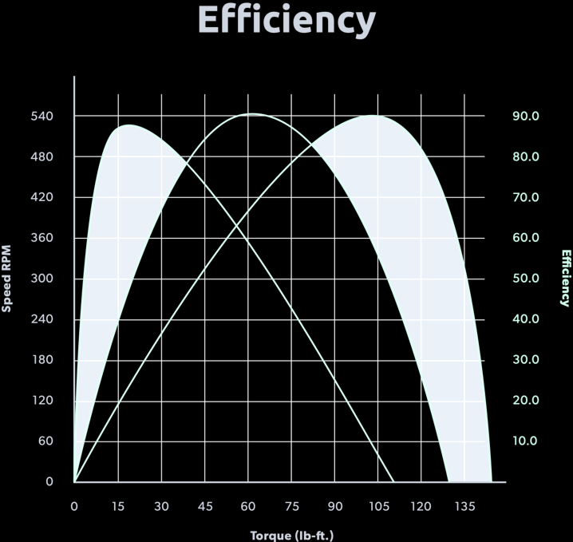
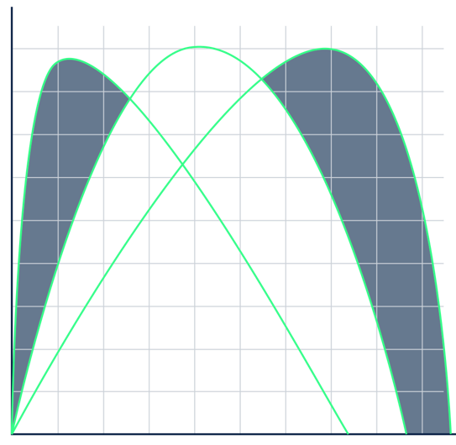
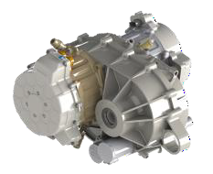
New Perspective | The Multi-Motor Advantage
By pairing multi-motor systems with intelligent route-level optimization
you seamlessly align the hardware performance profile with your vehicle demands
Accelitron addresses the problem from a
different perspective...
A patented approach:
Reduce energy loss and heat generation by using multiple motors with each efficient at a different combination of torque and RPM,
as well as multi-variate optimization to determine motor selection (including braking) to globally optimize over the entire trip.
Enhanced efficiency and decreased heat generation

Slide 5
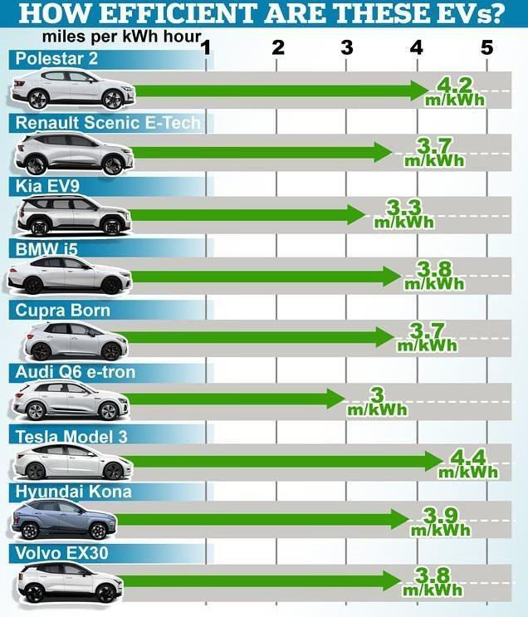
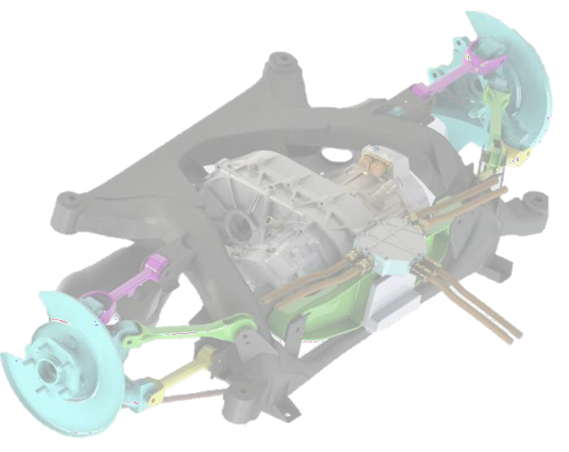
The Solution | Accelitron Multi-Motor Technology
Accelitron makes electric vehicles more efficient
Use the right motor for the right job
PLUS
Optimise motor selection with multiple variables calculated across the whole trip
EQUALS
Maximum efficiency and range with
minimum heat and wear at a hardware level
>5.5 m/kWh*
*24% range improvement validated in dedicated city-cycle trials

Slide 6
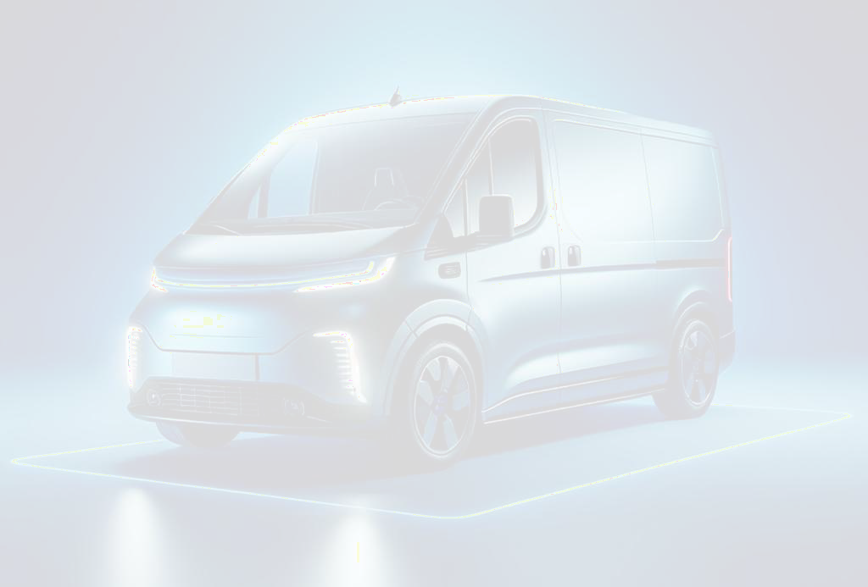
Value Prop | Efficiency, Efficiency, Efficiency
Delivery Van Fleet Case Study
Smaller Battery
Reduced Electricity Usage
Charge Less
Reduce battery size by >5kWh
Direct Material cost saving of
>$500 on every battery
On a standard parcel delivery route, Accelitron can save ~5kWh per shift
This results in a direct
operational cost saving -
>$50m/year for a large fleet
Accelitron can reduce your charge times by >10%
Realise benefits in uptime of vehicles in a fleet, fewer chargers, driver cost savings
Increased Range
More delivery routes now
viable for EVs
Fuel cost saving from internal combustion engine to EV
All data is based on simulated 3.5T delivery van, baseline configuration for comparison purposes is a single AC synchronous motor (interior permanent magnet) with peak efficiency of 97%

Slide 7
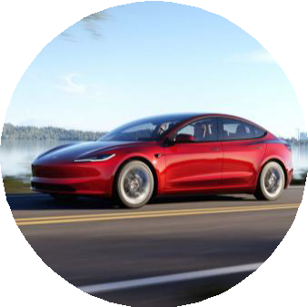
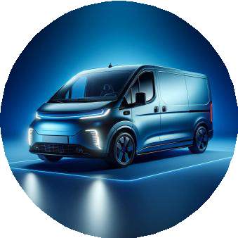
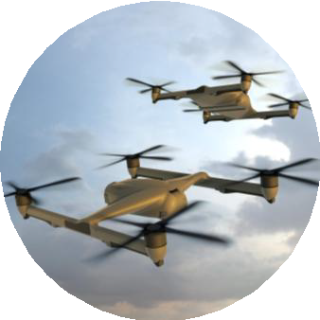
Value Prop | Wins in Adjacent Segments
Changing the Future of Transport at a Global Level
Electric motor and drive system suppliers have not enabled
multi-motor solutions in any segment
Consumers
Increase range, reduce maintenance,
and improve overall efficiency and performance
Commercial Fleets
Optimize logistics routes, reduce energy consumption and save driver costs
Aerospace & Defense
Achieve mission-critical performance
with extended range and system reliability
Commercial Marine
Unlock next-generation efficient electric propulsion for boats and autonomous vessels

Slide 8
Market | Large High-Growth Market
Accelitron has the potential to dominate the electric motor market with the most intelligent and efficient offering across a vast range of applications
$258Bn
Global Electric Motor Market
https://www.grandviewresearch.com/industry-analysis/electric-motor-market
32.5%
EV Market Compound Annual Growth
https://www.grandviewresearch.com/industry-analysis/electric-vehicles-ev-market

Slide 9
Global Impact | Accelerating Electrification Worldwide
Each year, with a 20% reduction in energy consumption, Accelitron has the potential to impact:
540 TWh of energy saved (almost 2% of the world’s electricity usage)
260,000 tons of CO₂ emissions avoided
Each year, with even a conservative 5% efficiency in driver-time, Accelitron can impact:
~104 driver-hours of time saved per year per vehicle for fleets
$1.15 billion saved in labor costs for UPS alone (with a fleet of 135,000 vehicles)
There are 32 million commercial vehicles in the US alone
Over the next 20 years, this translates to enormous impact:
10,800 TWh of energy saved
5.2 million tons of CO₂ emissions avoided
$22.95 billion saved in labor costs for UPS alone and immeasurably higher across all commercial vehicles
additional impact potential from air & sea applications
Global EV Energy Use: 2,700 TWh/year in 2035 (IEA Global EV Outlook 2024)
Global Energy CO₂ Intensity: 0.481kg CO₂ per kWh (Ember (2024); Energy Institute - Statistical Review of World Energy (2024)) Average driver total compensation (UPS): $170k & UPS total delivery vehicles: 135,000 (UPS)
US commercial vehicles: 32 million (NTEA U.S. Commercial Vehicle Market Report)

Slide 10
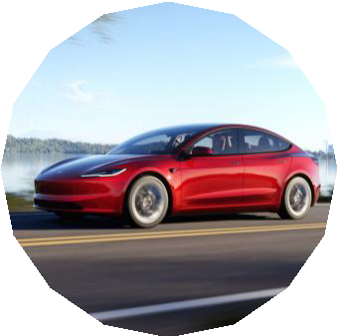
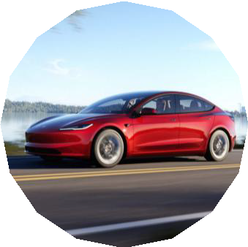
Project Timeline
Prototype development & Testing | Pre-Commercial Deployment & OEM Integration | Full scale production
2025 2026
Secure early testing partners Prototype validation
Software & Control system build
Production prototypes
2027
2028
2029
2030
2031
2032
Production ramp up & industrialization
Mass production
Prototype deployment in limited test environments
Pilot fleet trials, regulatory approvals
OEM Partnerships secured, commercial trials expand
Van fleet program #1
Van fleet program #3
Van fleet program #2
Passenger Car program #2
Passenger Car program #3
Passenger Car program #2
Global scale-up & additional market expansion
Aerospace, Defense, Marine

